Slide 1

Transformation
Let $r$ is position vector of $r\left(r_{1},r_{2},r_{3}\right)$ coordinate system.
Let $x$ is position vector of $x\left(x_{1},x_{2},x_{3}\right)$ coordinate system.
Let transformation is given by
$$𝔗:r\left(r_{1},r_{2},r_{3}\right)∈\tilde{Ω}↦x\left(x_{1},x_{2},x_{3}\right)∈Ω$$
A $𝔗$ is really just a function whose domain($\tilde{Ω})$ and range$(Ω)$ are both subsets of $ℝ^{3}$.
The point $x$ is image of the point $r$ and $Ω$ is image of $\tilde{Ω}$.
If no two points have the same image, $𝔗$ is called one-to-one and it has an inverse transformation $𝔗^{−1}$ from $Ω$ to $\tilde{Ω}$.

Slide 2

Definition of $ℙ^{n}$ transformation
Consider transformation function $𝔗_{i}$ which transform reference element $\tilde{Ω}$ to physical element $Ω_{i}$.
$$𝔗_{i}:r=\left(r,s,t\right)∈\tilde{Ω}↦x=\left(x,y,z\right)∈Ω_{i}$$
If $𝔗_{i}$ is expressed by polynomial and it become 1D $ℙ^{n}$ polynomial on each sides in $\tilde{Ω}$, then we call $𝔗_{i}$ is $ℙ^{n}$ transformation.

Slide 3
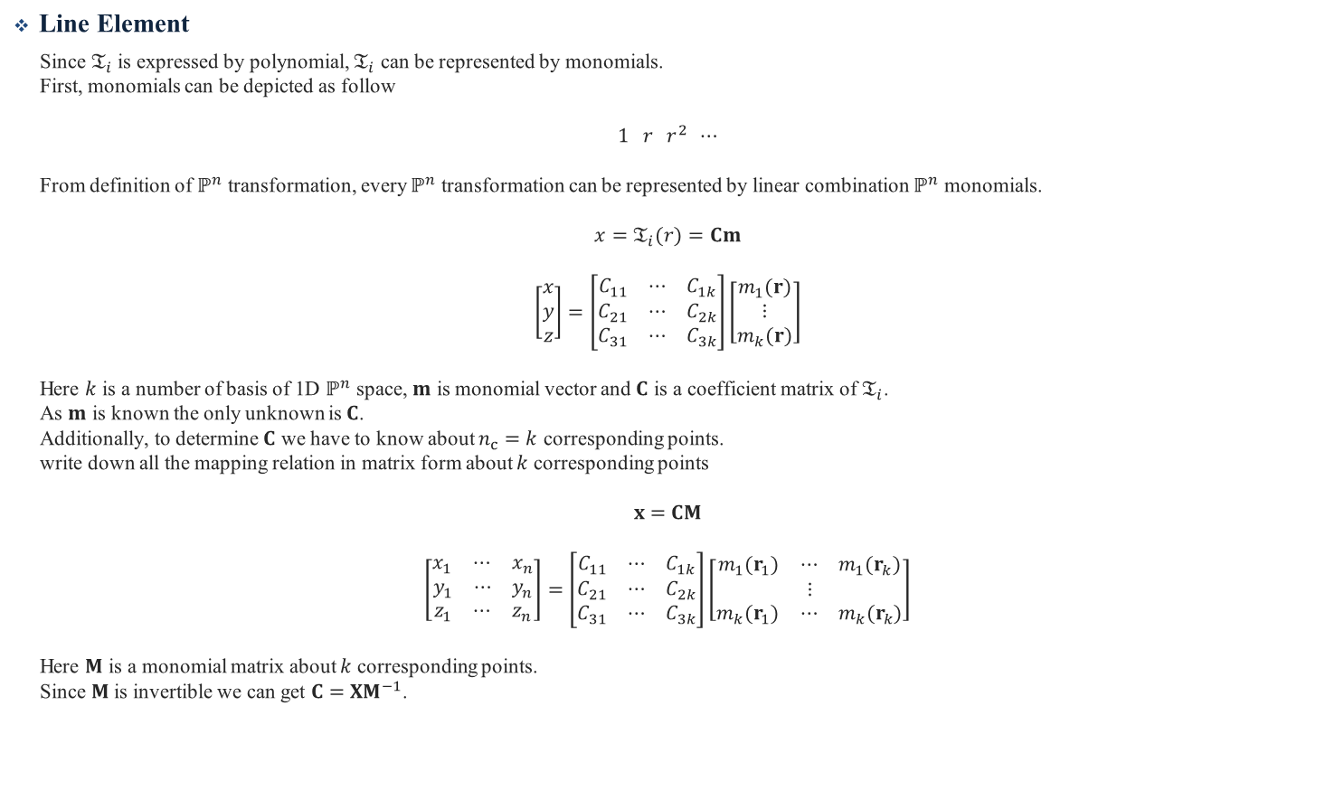
Line Element
Since $𝔗_{i}$ is expressed by polynomial, $𝔗_{i}$ can be represented by monomials.
First, monomials can be depicted as follow
$$1 r r^{2} ⋯$$
From definition of $ℙ^{n}$ transformation, every $ℙ^{n}$ transformation can be represented by linear combination $ℙ^{n}$ monomials.
$$x=𝔗_{i}(r)=Cm$$
$$\left[\begin{aligned}x \\ y \\ z\end{aligned}\right]=\left[\begin{aligned}\begin{matrix}C_{11} & ⋯ & C_{1k}\end{matrix} \\ \begin{matrix}C_{21} & ⋯ & C_{2k}\end{matrix} \\ \begin{matrix}C_{31} & ⋯ & C_{3k}\end{matrix}\end{aligned}\right]\left[\begin{aligned}m_{1}(r) \\ ⋮ \\ m_{k}(r)\end{aligned}\right]$$
Here $k$ is a number of basis of 1D $ℙ^{n}$ space, $m$ is monomial vector and $C$ is a coefficient matrix of $𝔗_{i}$.
As $m$ is known the only unknown is $C$.
Additionally, to determine $C$ we have to know about $n_{c}=k$ corresponding points.
write down all the mapping relation in matrix form about $k$ corresponding points
$$x=CM$$
$$\left[\begin{aligned}\begin{matrix}x_{1} & ⋯ & x_{n}\end{matrix} \\ \begin{matrix}y_{1} & ⋯ & y_{n}\end{matrix} \\ \begin{matrix}z_{1} & ⋯ & z_{n}\end{matrix}\end{aligned}\right]=\left[\begin{aligned}\begin{matrix}C_{11} & ⋯ & C_{1k}\end{matrix} \\ \begin{matrix}C_{21} & ⋯ & C_{2k}\end{matrix} \\ \begin{matrix}C_{31} & ⋯ & C_{3k}\end{matrix}\end{aligned}\right]\left[\begin{aligned}\begin{matrix}m_{1}(r_{1}) & ⋯ & m_{1}(r_{k})\end{matrix} \\ ⋮ \\ \begin{matrix}m_{k}(r_{1}) & ⋯ & m_{k}(r_{k})\end{matrix}\end{aligned}\right]$$
Here $M$ is a monomial matrix about $k$ corresponding points.
Since $M$ is invertible we can get $C=XM^{−1}$.

Slide 4




Transformation Function
Triangle Element
Since $𝔗_{i}$ is expressed by polynomial, $𝔗_{i}$ can be represented by monomials.
First, monomials can be depicted as follow
$$\begin{matrix}1 \\ \begin{aligned}\begin{aligned}\begin{matrix}r & s\end{matrix} \\ \begin{matrix}r^{2} & rs & s^{2}\end{matrix} \\ \begin{matrix}\begin{matrix}r^{3} & r^{2}s\end{matrix} & \begin{matrix}s^{2}r & s^{3}\end{matrix}\end{matrix}\end{aligned} \\ \\ ⋮\end{aligned}\end{matrix}$$
Here $ℙ^{n}$ block have every monomials above each $ℙ^{n}$ block line.
We can easily verify that monomials in $ℙ^{n}$ block become 1D $ℙ^{n}$ polynomial at each sides in reference triangle element.
To be more specific in reference triangle case, It have three sides $L_{j}$ and each sides can be parameterized by one variable $φ_{j}$ as follow
$$\left\{\begin{matrix}L_{1}: & r=φ_{1} & s=−1 \\ L_{2}: & r=φ_{2} & s=−φ_{2} \\ L_{3}: & r=−1 & s=φ_{3} \end{matrix}\right.$$
From definition of $ℙ^{n}$ transformation, every $ℙ^{n}$ transformation can be represented by linear combination of $ℙ^{n}$ block monomial.
$$ℙ^{1} block line$$
$$ℙ^{2} block line$$
$$ℙ^{3} block line$$

Slide 5
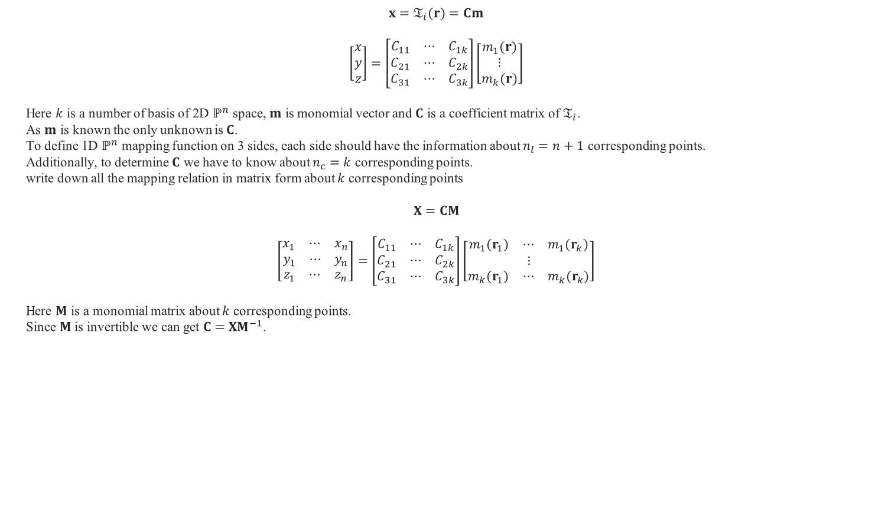
$$x=𝔗_{i}(r)=Cm$$
$$\left[\begin{aligned}x \\ y \\ z\end{aligned}\right]=\left[\begin{aligned}\begin{matrix}C_{11} & ⋯ & C_{1k}\end{matrix} \\ \begin{matrix}C_{21} & ⋯ & C_{2k}\end{matrix} \\ \begin{matrix}C_{31} & ⋯ & C_{3k}\end{matrix}\end{aligned}\right]\left[\begin{aligned}m_{1}(r) \\ ⋮ \\ m_{k}(r)\end{aligned}\right]$$
Here $k$ is a number of basis of 2D $ℙ^{n}$ space, $m$ is monomial vector and $C$ is a coefficient matrix of $𝔗_{i}$.
As $m$ is known the only unknown is $C$.
To define 1D $ℙ^{n}$ mapping function on 3 sides, each side should have the information about $n_{l}=n+1$ corresponding points.
Additionally, to determine $C$ we have to know about $n_{c}=k$ corresponding points.
write down all the mapping relation in matrix form about $k$ corresponding points
$$X=CM$$
$$\left[\begin{aligned}\begin{matrix}x_{1} & ⋯ & x_{n}\end{matrix} \\ \begin{matrix}y_{1} & ⋯ & y_{n}\end{matrix} \\ \begin{matrix}z_{1} & ⋯ & z_{n}\end{matrix}\end{aligned}\right]=\left[\begin{aligned}\begin{matrix}C_{11} & ⋯ & C_{1k}\end{matrix} \\ \begin{matrix}C_{21} & ⋯ & C_{2k}\end{matrix} \\ \begin{matrix}C_{31} & ⋯ & C_{3k}\end{matrix}\end{aligned}\right]\left[\begin{aligned}\begin{matrix}m_{1}(r_{1}) & ⋯ & m_{1}(r_{k})\end{matrix} \\ ⋮ \\ \begin{matrix}m_{k}(r_{1}) & ⋯ & m_{k}(r_{k})\end{matrix}\end{aligned}\right]$$
Here $M$ is a monomial matrix about $k$ corresponding points.
Since $M$ is invertible we can get $C=XM^{−1}$.

Slide 6














Appendix 1
Domain Transformation of Volume Integral
Let’s consider 2D integration on arbitrary surface $S$
$$\int_{S}{F(x,y)}dS$$
Let $A$ be reference element.
Assume $^{∃}𝔗_{i}:r=\left(u,v\right)∈A↦x=\left(x,y\right)∈S$.
Next, we consider small part of element $∆A , ∆S$ and explore relationship between them.
Let $a=x\left(u_{0}+∆u,v_{0}\right)−x\left(u_{0},v_{0}\right)$ and $b=x\left(u_{0},v_{0}+∆V\right)−x(u_{0},v_{0})$.
Then $a≈x_{r}∆u, b≈x_{s}∆v$ by definition of partial derivate.
Thus $∆S≅\left|a×b\right|≈\left|x_{r}×x_{s}\right|∆u∆v=\left|x_{r}×x_{s}\right|∆A=\left|det⁡(J)\right|∆A$ ($∆S=\left|det(J)\right|∆A$ When $\left|det(J)\right|=const$)
using Reimann integral notion
$$\int_{S}{F}dS=\int_{A}{\left(F∘𝔗_{i}\right)|J|}dA$$
$$v$$
$$∆u$$
$$y$$
$$∆A$$
$∆$S
$$∆v$$
$$𝔗_{i}$$
$$b$$
$$\left(u_{0},v_{0}\right)$$
$$\left(x_{0},y_{0}\right)$$
$$a$$
$$u$$
$$x$$

Slide 7
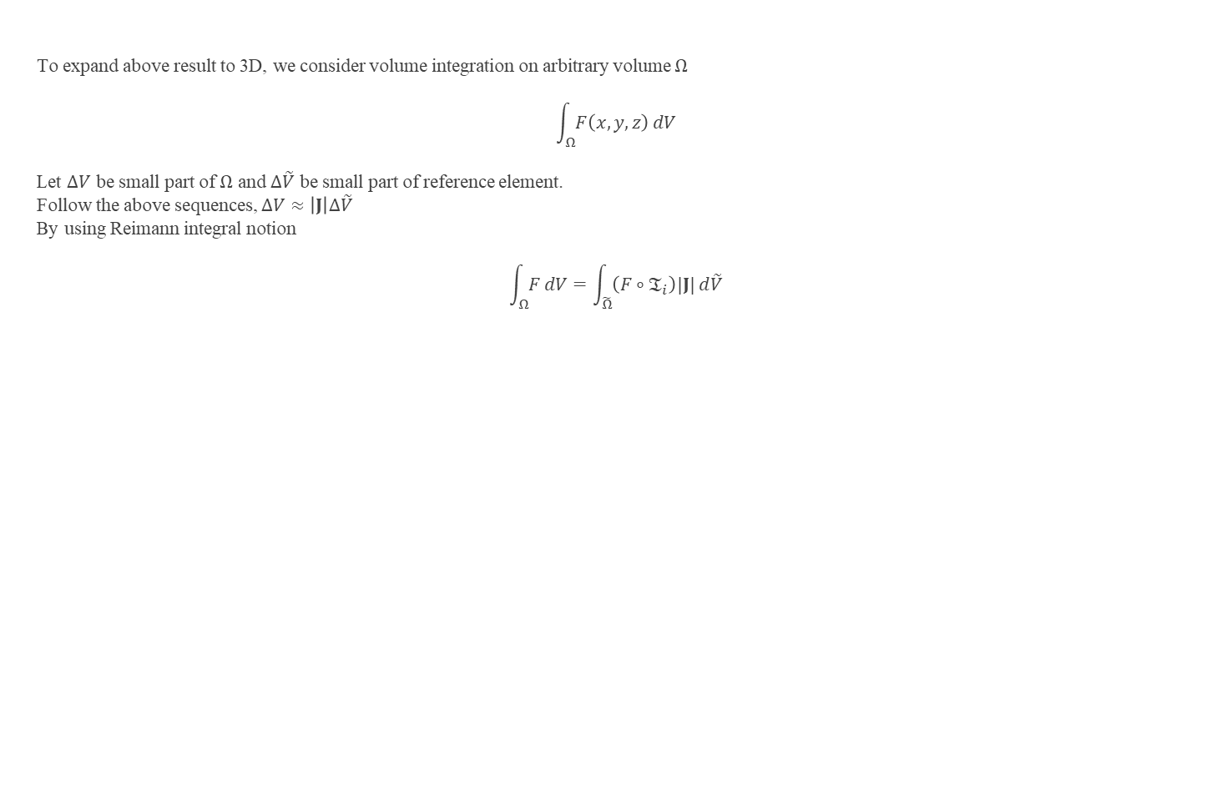
Appendix 1
To expand above result to 3D, we consider volume integration on arbitrary volume $Ω$
$$\int_{Ω}{F\left(x,y,z\right)}dV$$
Let $∆V$ be small part of $Ω$ and $∆\tilde{V}$ be small part of reference element.
Follow the above sequences, $∆V≈\left|J\right|∆\tilde{V}$
By using Reimann integral notion
$$\int_{Ω}{F}dV=\int_{\tilde{Ω}}{\left(F∘𝔗_{i}\right)|J|}d\tilde{V}$$

Slide 8
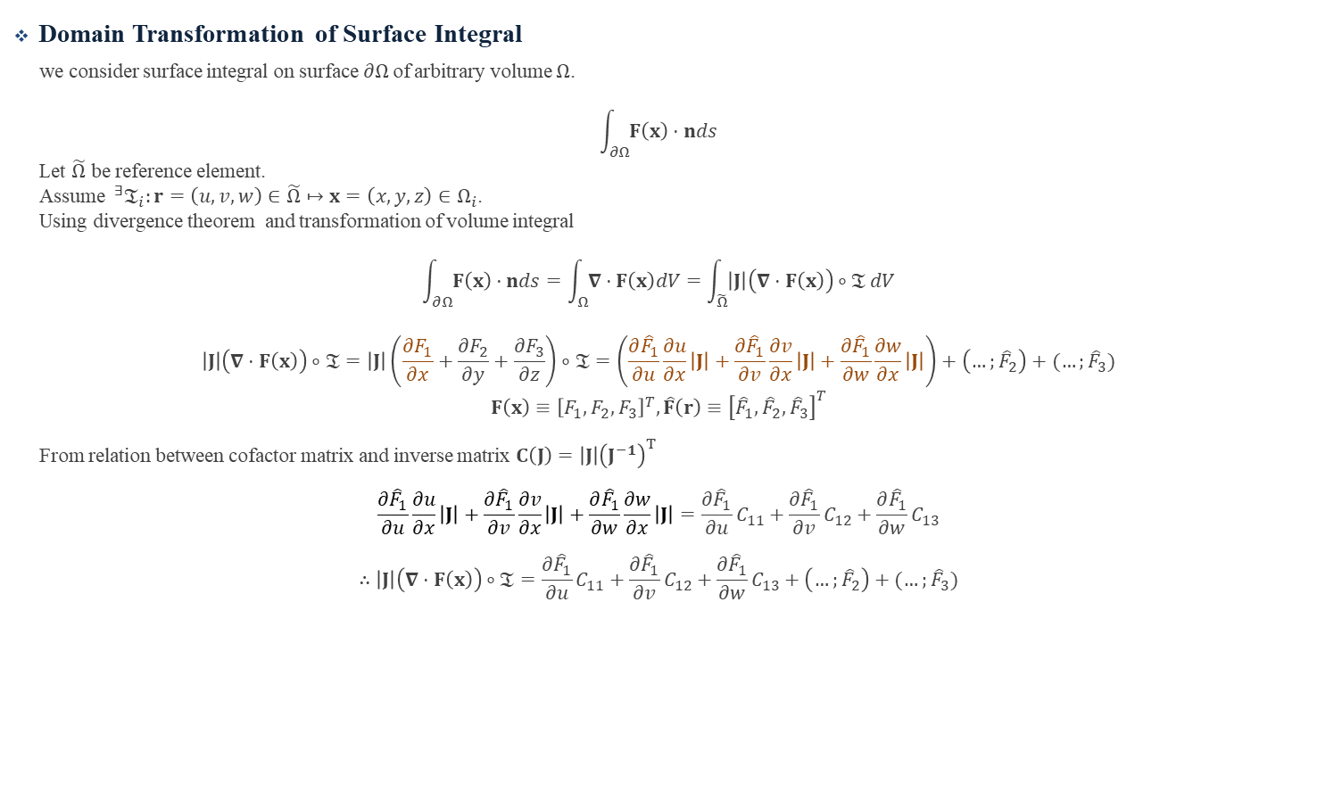
Appendix 2
Domain Transformation of Surface Integral
we consider surface integral on surface $∂Ω$of arbitrary volume $Ω$.
$$\int_{∂Ω}{F\left(x\right)⋅nds}$$
Let $\tilde{Ω}$ be reference element.
Assume $^{∃}𝔗_{i}:r=\left(u,v,w\right)∈\tilde{Ω}↦x=\left(x,y,z\right)∈Ω_{i}$.
Using divergence theorem and transformation of volume integral
$$\int_{∂Ω}{F\left(x\right)⋅nds}=\int_{Ω}{∇⋅F\left(x\right)dV}=\int_{\tilde{Ω}}{\left|J\right|\left(∇⋅F\left(x\right)\right)∘𝔗}dV$$
$$\left|J\right|\left(∇⋅F\left(x\right)\right)∘𝔗=\left|J\right|\left(\frac{∂F_{1}}{∂x}+\frac{∂F_{2}}{∂y}+\frac{∂F_{3}}{∂z}\right)∘𝔗=\left(\frac{∂{\hat{F}}_{1}}{∂u}\frac{∂u}{∂x}\left|J\right|+\frac{∂{\hat{F}}_{1}}{∂v}\frac{∂v}{∂x}\left|J\right|+\frac{∂{\hat{F}}_{1}}{∂w}\frac{∂w}{∂x}\left|J\right|\right)+\left(…;{\hat{F}}_{2}\right)+(…;{\hat{F}}_{3})$$
$$F\left(x\right)≡{\left[F_{1},F_{2},F_{3}\right]}^{T},\hat{F}\left(r\right)≡{\left[{\hat{F}}_{1},{\hat{F}}_{2},{\hat{F}}_{3}\right]}^{T}$$
From relation between cofactor matrix and inverse matrix $C\left(J\right)=\left|J\right|{\left(J^{−1}\right)}^{T}$
$$\frac{∂{\hat{F}}_{1}}{∂u}\frac{∂u}{∂x}\left|J\right|+\frac{∂{\hat{F}}_{1}}{∂v}\frac{∂v}{∂x}\left|J\right|+\frac{∂{\hat{F}}_{1}}{∂w}\frac{∂w}{∂x}\left|J\right|=\frac{∂{\hat{F}}_{1}}{∂u}C_{11}+\frac{∂{\hat{F}}_{1}}{∂v}C_{12}+\frac{∂{\hat{F}}_{1}}{∂w}C_{13}$$
$$∴\left|J\right|\left(∇⋅F\left(x\right)\right)∘𝔗=\frac{∂{\hat{F}}_{1}}{∂u}C_{11}+\frac{∂{\hat{F}}_{1}}{∂v}C_{12}+\frac{∂{\hat{F}}_{1}}{∂w}C_{13}+\left(…;{\hat{F}}_{2}\right)+(…;{\hat{F}}_{3})$$

Slide 9
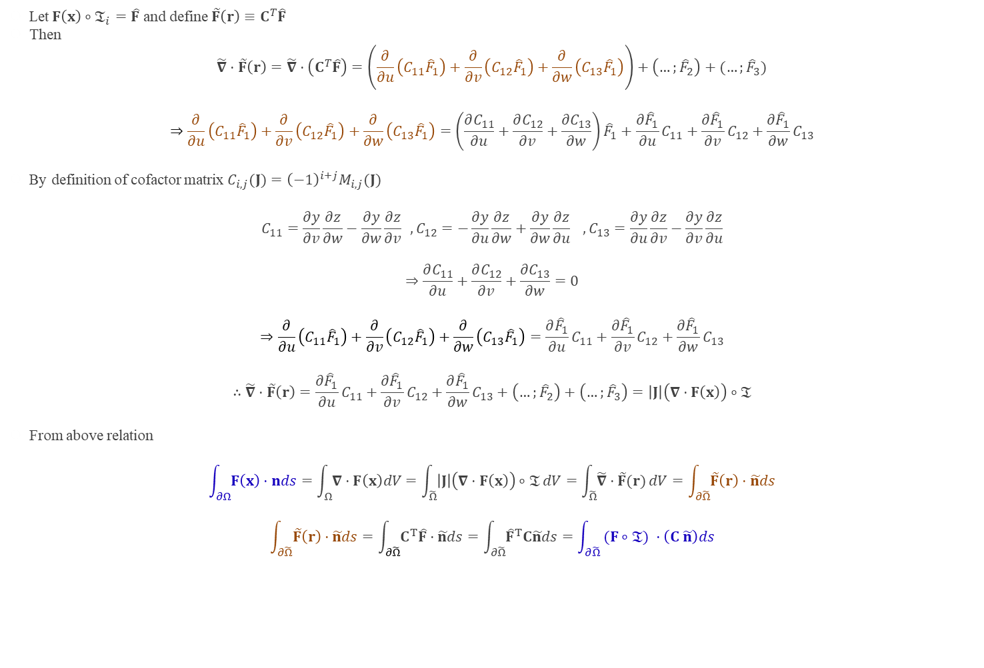
Appendix 2
Let$F\left(x\right)∘𝔗_{i}=\hat{F}$ and define $\tilde{F}\left(r\right)≡C^{T}\hat{F}$
Then
$$\tilde{∇}⋅\tilde{F}\left(r\right)=\tilde{∇}⋅\left(C^{T}\hat{F}\right)=\left(\frac{∂}{∂u}\left(C_{11}{\hat{F}}_{1}\right)+\frac{∂}{∂v}\left(C_{12}{\hat{F}}_{1}\right)+\frac{∂}{∂w}\left(C_{13}{\hat{F}}_{1}\right)\right)+\left(…;{\hat{F}}_{2}\right)+(…;{\hat{F}}_{3})$$
$$⇒\frac{∂}{∂u}\left(C_{11}{\hat{F}}_{1}\right)+\frac{∂}{∂v}\left(C_{12}{\hat{F}}_{1}\right)+\frac{∂}{∂w}\left(C_{13}{\hat{F}}_{1}\right)=\left(\frac{∂C_{11}}{∂u}+\frac{∂C_{12}}{∂v}+\frac{∂C_{13}}{∂w}\right){\hat{F}}_{1}+\frac{∂{\hat{F}}_{1}}{∂u}C_{11}+\frac{∂{\hat{F}}_{1}}{∂v}C_{12}+\frac{∂{\hat{F}}_{1}}{∂w}C_{13}$$
By definition of cofactor matrix $C_{i,j}(J)={\left(−1\right)}^{i+j}M_{i,j}(J)$
$$C_{11}=\frac{∂y}{∂v}\frac{∂z}{∂w}−\frac{∂y}{∂w}\frac{∂z}{∂v} ,C_{12}=−\frac{∂y}{∂u}\frac{∂z}{∂w}+\frac{∂y}{∂w}\frac{∂z}{∂u} ,C_{13}=\frac{∂y}{∂u}\frac{∂z}{∂v}−\frac{∂y}{∂v}\frac{∂z}{∂u}$$
$$⇒\frac{∂C_{11}}{∂u}+\frac{∂C_{12}}{∂v}+\frac{∂C_{13}}{∂w}=0$$
$$⇒\frac{∂}{∂u}\left(C_{11}{\hat{F}}_{1}\right)+\frac{∂}{∂v}\left(C_{12}{\hat{F}}_{1}\right)+\frac{∂}{∂w}\left(C_{13}{\hat{F}}_{1}\right)=\frac{∂{\hat{F}}_{1}}{∂u}C_{11}+\frac{∂{\hat{F}}_{1}}{∂v}C_{12}+\frac{∂{\hat{F}}_{1}}{∂w}C_{13}$$
$$∴\tilde{∇}⋅\tilde{F}\left(r\right)=\frac{∂{\hat{F}}_{1}}{∂u}C_{11}+\frac{∂{\hat{F}}_{1}}{∂v}C_{12}+\frac{∂{\hat{F}}_{1}}{∂w}C_{13}+\left(…;{\hat{F}}_{2}\right)+\left(…;{\hat{F}}_{3}\right)=\left|J\right|\left(∇⋅F\left(x\right)\right)∘𝔗$$
From above relation
$$\int_{∂Ω}{F\left(x\right)⋅nds}=\int_{Ω}{∇⋅F\left(x\right)dV}=\int_{\tilde{Ω}}{\left|J\right|\left(∇⋅F\left(x\right)\right)∘𝔗}dV=\int_{\tilde{Ω}}{\tilde{∇}⋅\tilde{F}(r)}dV=\int_{∂\tilde{Ω}}{\tilde{F}\left(r\right)⋅\tilde{n}ds}$$
$$\int_{∂\tilde{Ω}}{\tilde{F}\left(r\right)⋅\tilde{n}ds}=\int_{∂\tilde{Ω}}{C^{T}\hat{F}⋅\tilde{n}ds}=\int_{∂\tilde{Ω}}{{\hat{F}}^{T}C\tilde{n}ds}=\int_{∂\tilde{Ω}}{ (F∘𝔗) ⋅\left(C \tilde{n}\right)ds}$$

Slide 10















Appendix 3
Transformation of Normal Vector
We consider surface normal vector $\tilde{n}$ in reference element $\tilde{Ω}$ which is tangent to the surface at $r$.
Then we assume there is a invertible transformation operator $𝔗_{i}$ which mapping from reference element $\tilde{Ω}$ to physical element $Ω$.
$$𝔗_{i}:r=\left(u,v,w\right)∈\tilde{Ω}↦x=\left(x,y,z\right)∈Ω_{ }$$
$$x=x(r)$$
Then we want to know surface normal vector $n$ in physical element which is tangent to the surface at $x$.
Unfortunately, it can’t be obtained by simple transformation
$$𝔗_{i}\left(\tilde{n}\right)≠n$$
To get surface normal vector $n$ in physical element, we use the fact that $n$ is tangent to the surface at $x$.
First we define infinitesimally small vector $∆r$ in $Ω_{i}$
$$∆r=r_{n}−r$$
$$η$$
$$\tilde{n}$$
$$y$$
$$∆r$$
$$Ω_{ }$$
$$n$$
$$r$$
$$r_{n}$$
$$𝔗_{i}$$
$$x$$
$$∆x$$
$$\tilde{Ω}$$
$$x_{n}$$
$$ξ$$
$$x$$

Slide 11

Appendix 3
Since we assume infinitesimally small $∆r$ we can safely say
$$∆r⋅\tilde{n}=0$$
and
$$∆x≅J(r)∆r$$
From the fact that $n$ and $∆x$ must be orthogonal
$$∆x⋅n=\left(J\left(r\right)∆r\right)⋅n={\left(∆r\right)}^{T}J{\left(r\right)}^{T}n=0$$
To satisfy above relation
$$n={\left(J{\left(r\right)}^{T}\right)}^{−1}\tilde{n}$$
Normalize it
$$\frac{n}{\left\|n\right\|}=\frac{{\left(J{\left(r\right)}^{T}\right)}^{−1}\tilde{n}}{\left\|{\left(J{\left(r\right)}^{T}\right)}^{−1}\tilde{n}\right\|}=\frac{det(J){\left(J{\left(r\right)}^{T}\right)}^{−1}\tilde{n}}{det(J)\left\|{\left(J{\left(r\right)}^{T}\right)}^{−1}\tilde{n}\right\|}=\frac{C\tilde{n}}{\left\|C\tilde{n}\right\|}$$

